Slide 1
Cleaning Data
Sean McMinn
Digital frameworks
Northwestern University – Summer 2018
Github.com/shmcminn/digitalframeworks-summer18

Slide 2
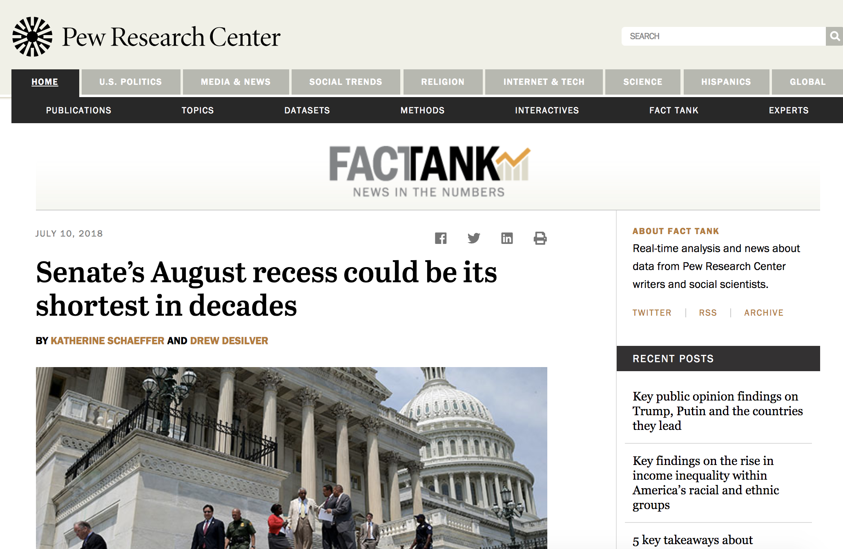
Data stories?
http://www.pewresearch.org/fact-tank/2018/07/10/senates-august-recess-could-be-its-shortest-in-decades/

Slide 3
Steps to a data story
Find data
Clean data
Analyze data
Present data

Slide 4
Agenda
Five cleaning activities done with partners
Advanced cleaning techniques using Sublime Text and Excel

Slide 5
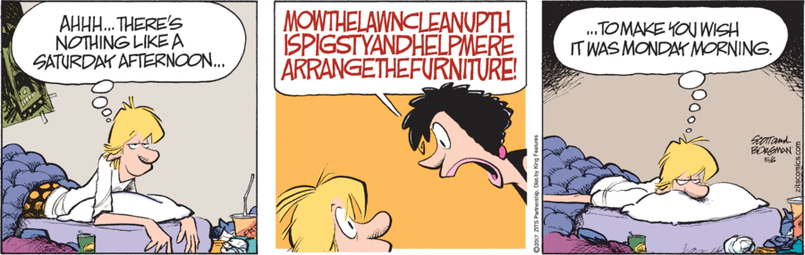
Data cleaning

Slide 6
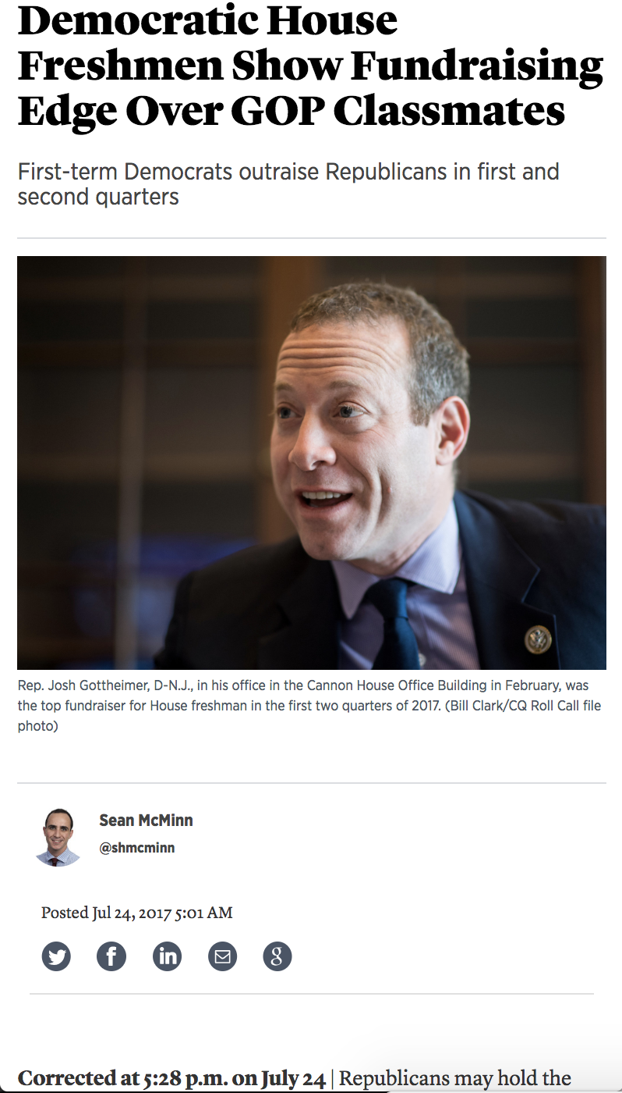
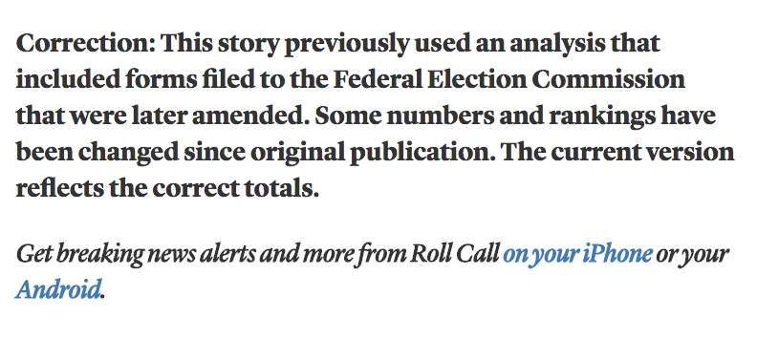
Data cleaning
Prevents this

Slide 7
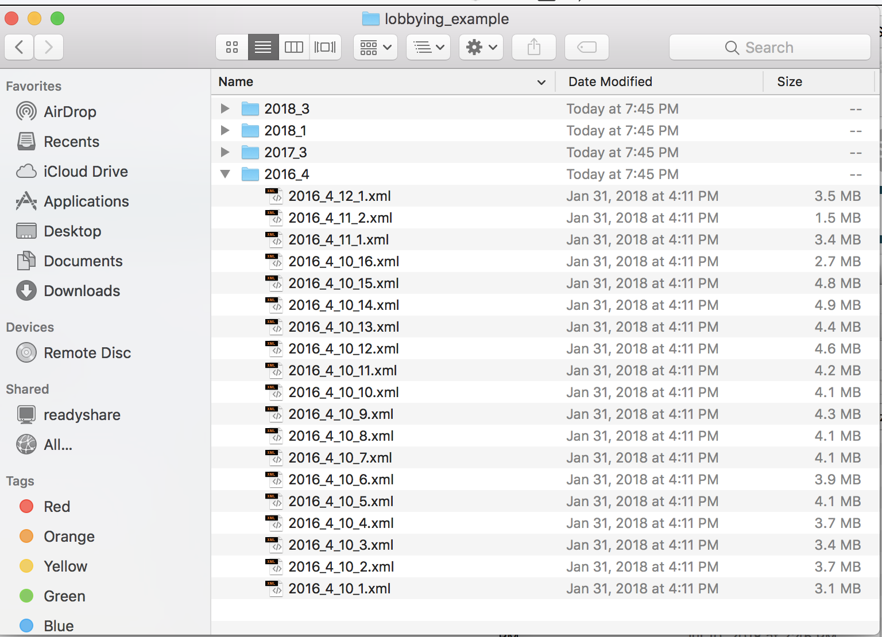
Data cleaning
And let’s you turn this

Slide 8
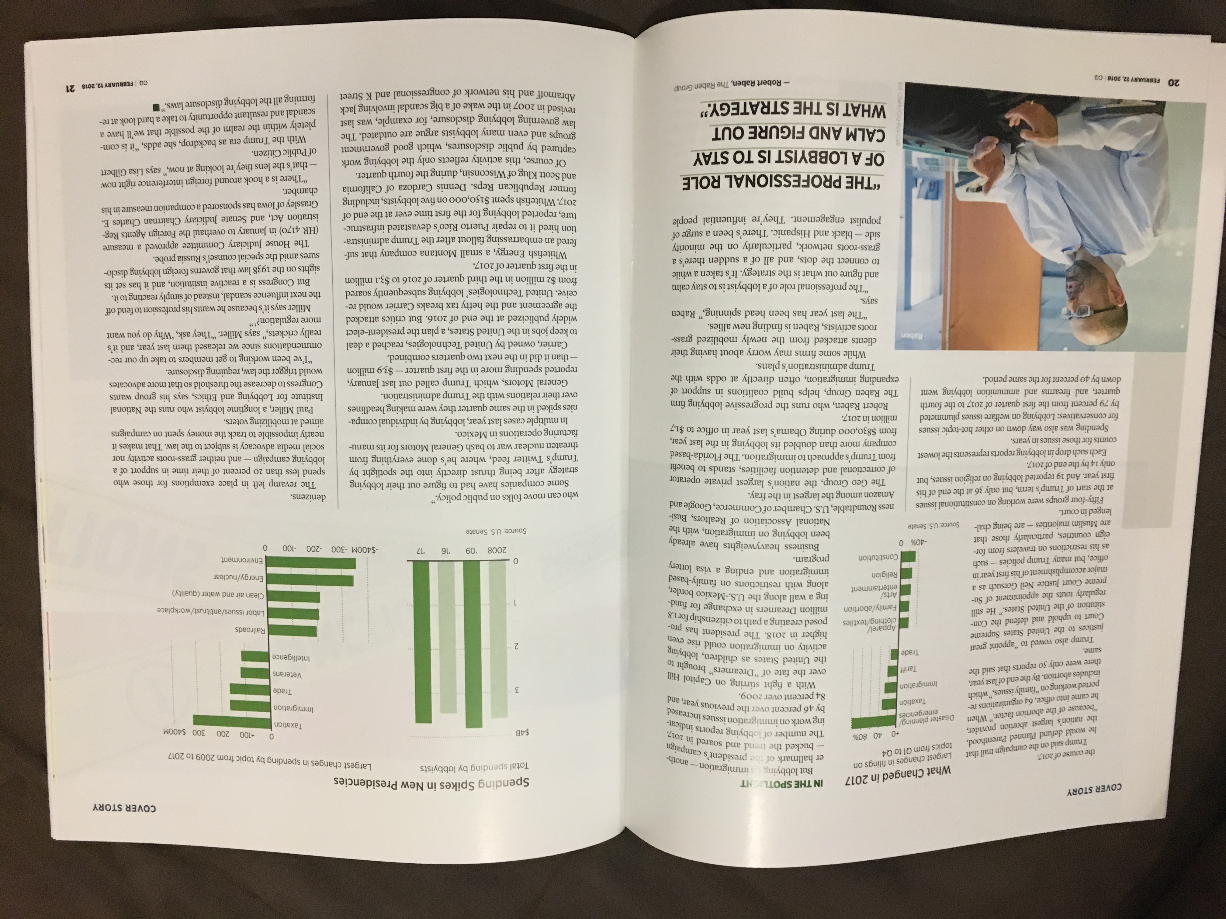
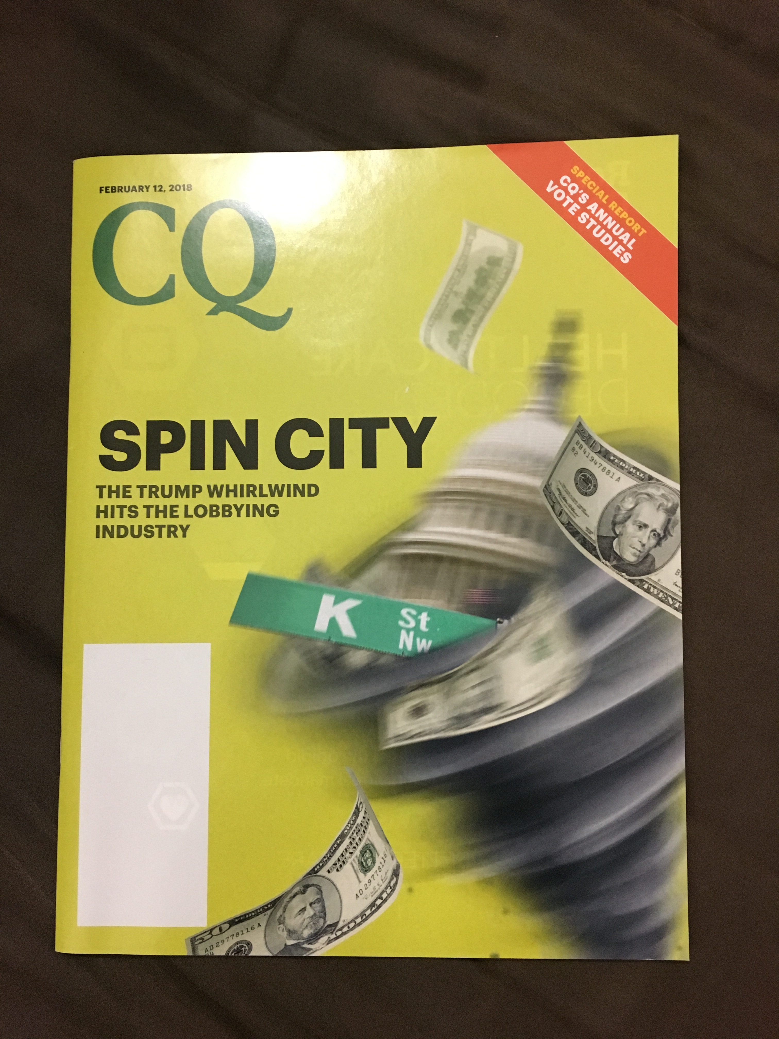
Data cleaning
Into this

Slide 9
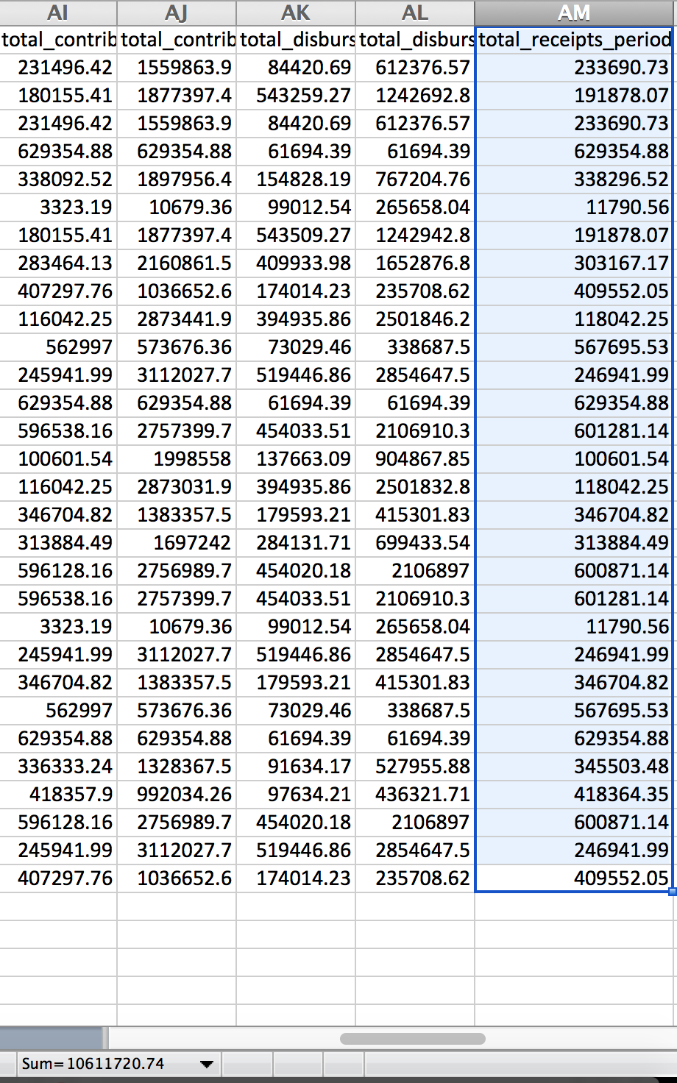
Data cleaning
How you can (read: I did) mess up if you don’t clean

Slide 10
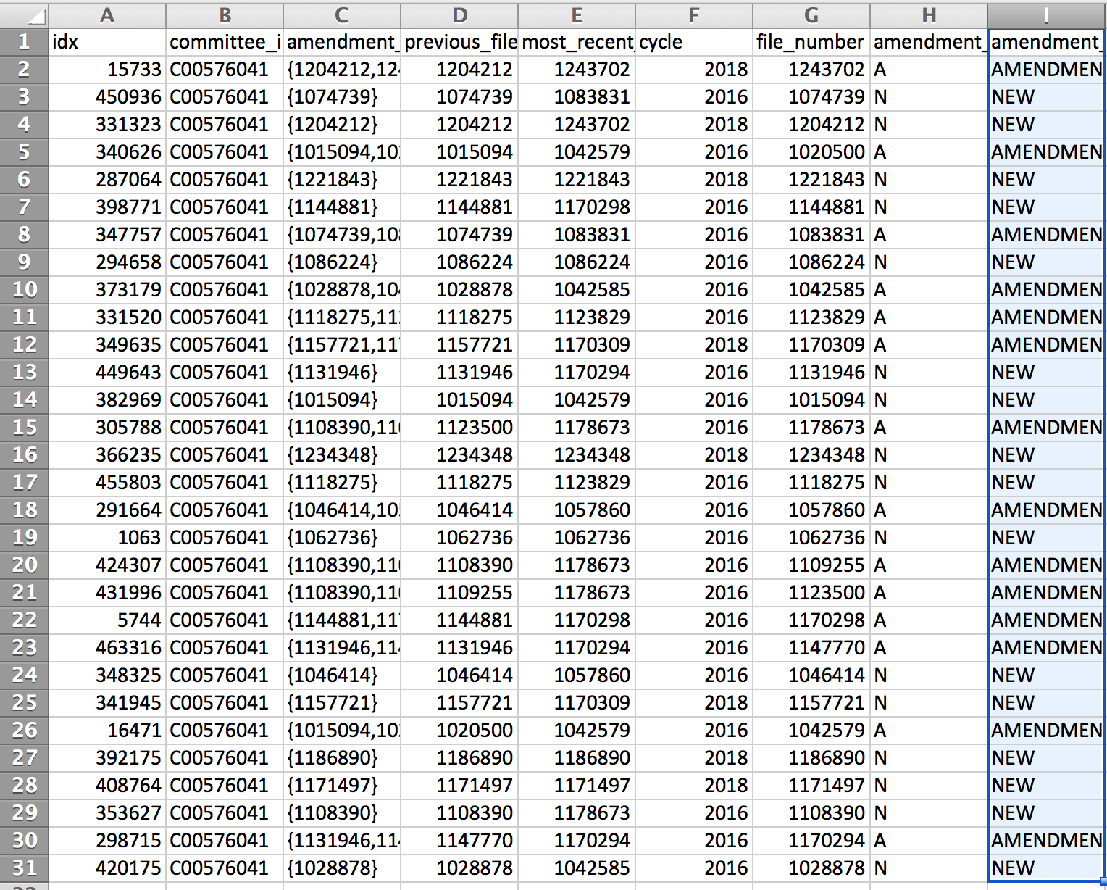
Data cleaning
How you can (read: I did) mess up if you don’t clean

Slide 11
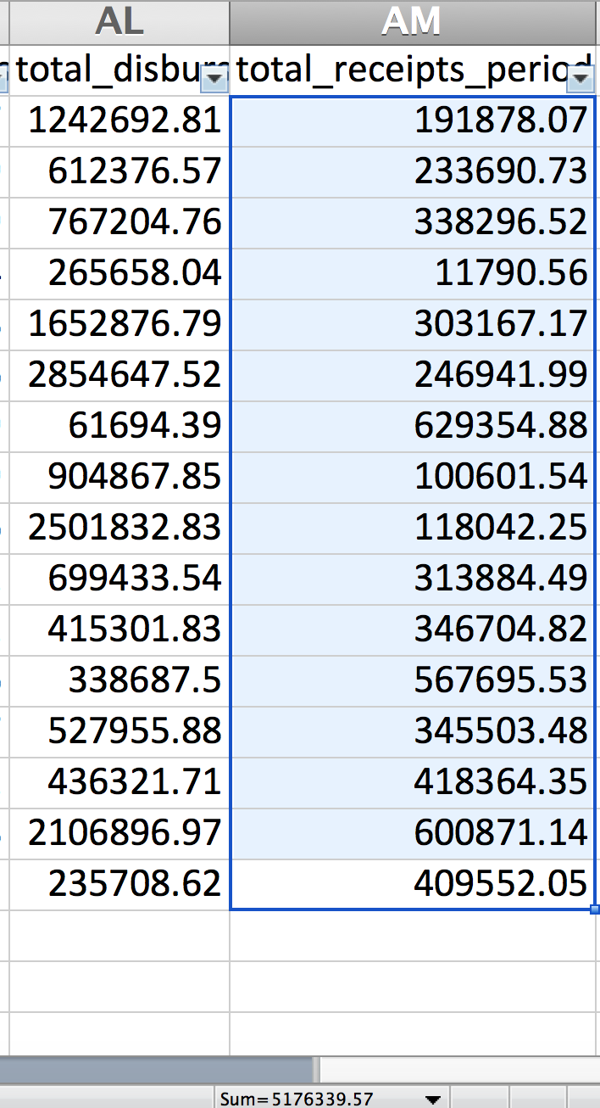
Data cleaning
How you can (read: I did) mess up if you don’t clean

Slide 12
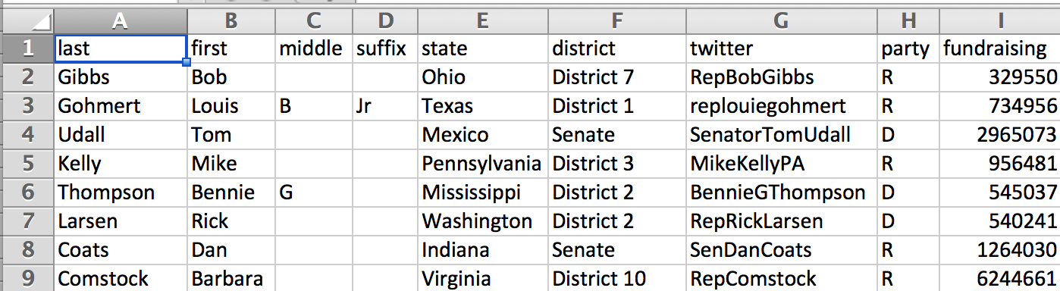
Data examples
“Good” (slash very fake) fundraising data

Slide 13
Data examples
“Good” (slash very fake) fundraising data
Separate fields in separate columns

Slide 14
Data examples
“Good” (slash very fake) fundraising data
Separate fields in separate columns
States and districts formatted the same

Slide 15
Data examples
“Good” (slash very fake) fundraising data
Clean numbers (no commas, $ signs)
Separate fields in separate columns
States and districts formatted the same

Slide 16
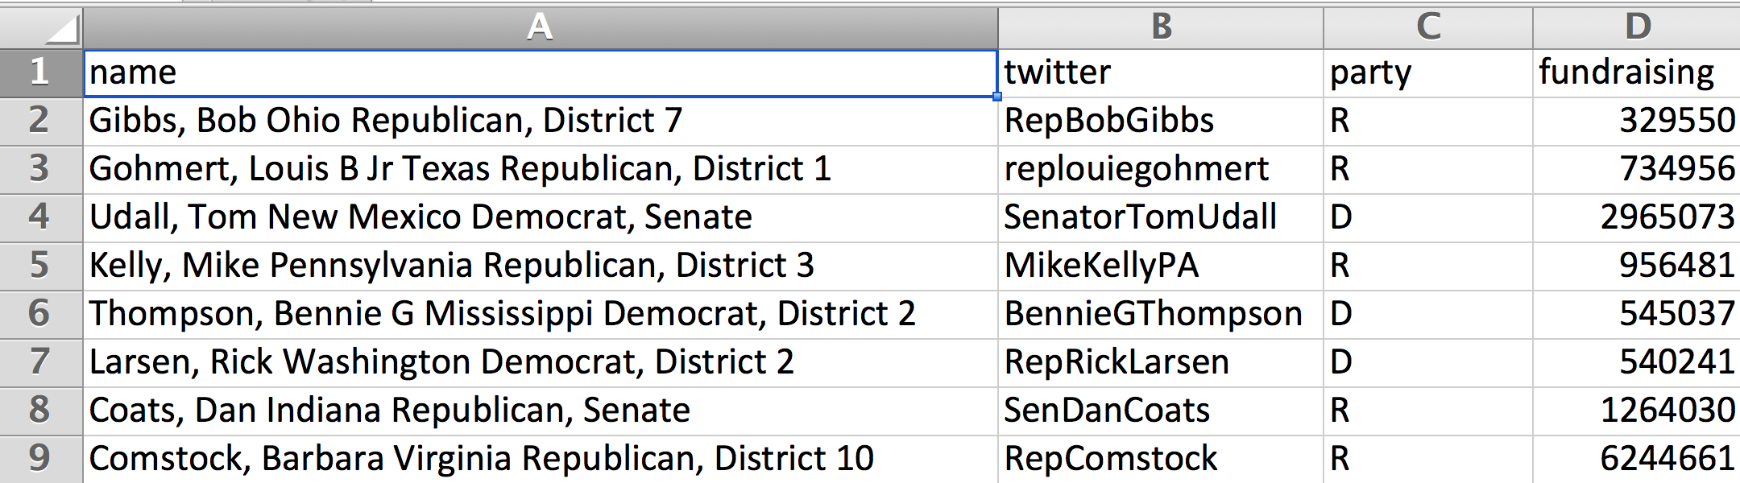
Data examples
How that data started out
Lots mashed together for each data point
Redundant column

Slide 17
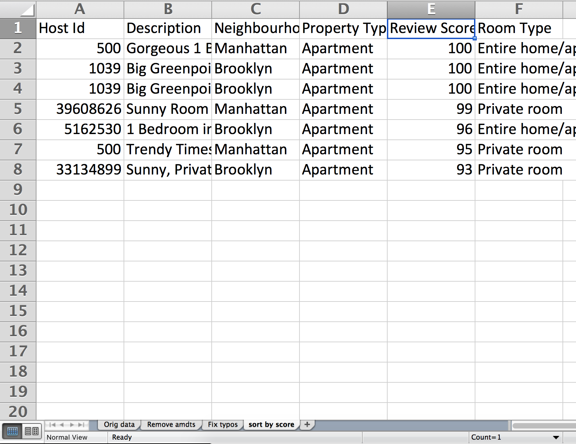
First, a word
Always work on a COPY of your data!
Always keep a RECORD of what you’re doing to your data
Example:

Slide 18
First, a word
Always work on a COPY of your data!
Always keep a RECORD of what you’re doing to your data
Example:

Slide 19
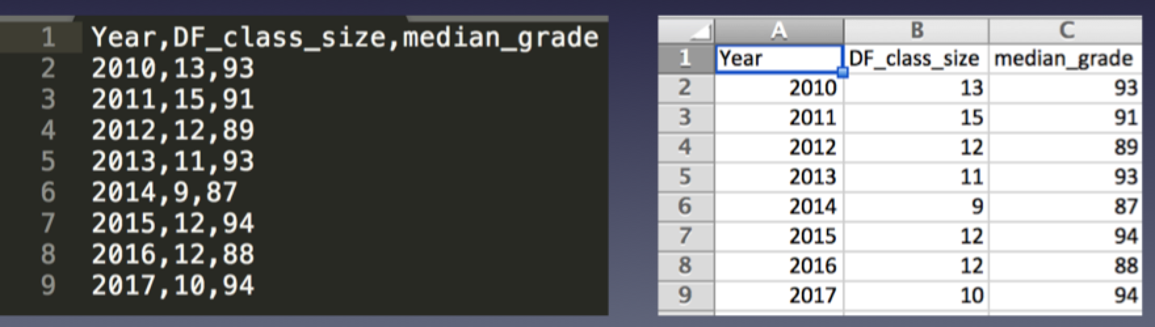
CSV => Excel
Excel can interpret CSV files very well! Sometimes.
This is going to focus on spreadsheets, but many of the same principles apply to other data formats

Slide 20
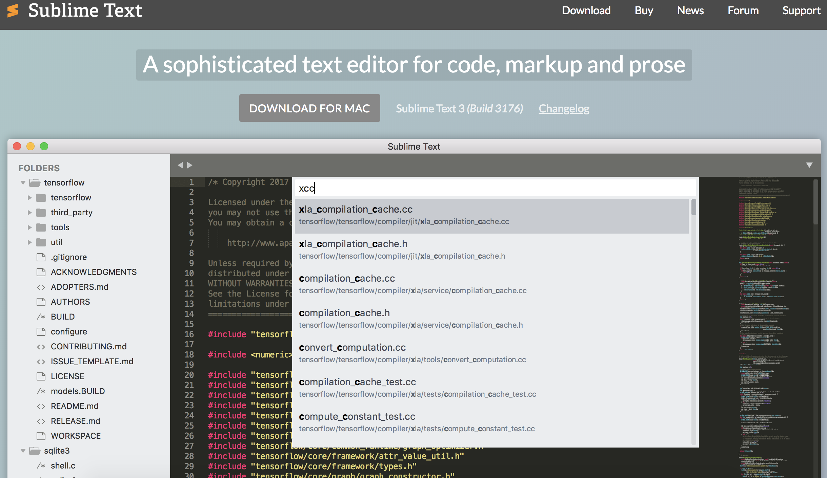
First …
Download text editor
sublimetext.com/3

Slide 21
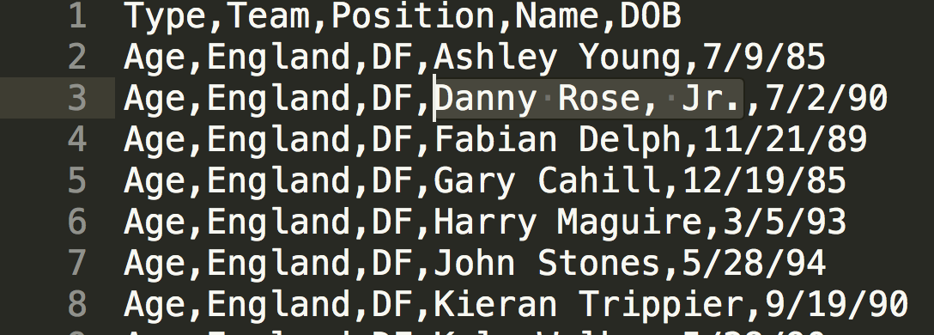
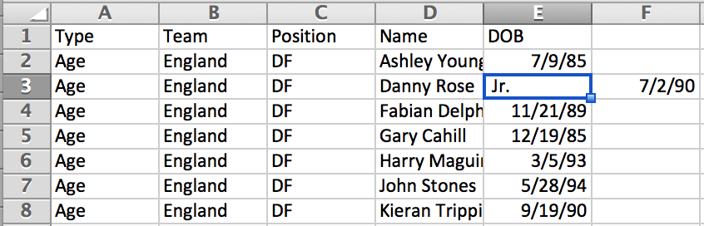
What to watch out for
Extra comma
(not actually a Jr.)
¯\_(ツ)_/¯

Slide 22
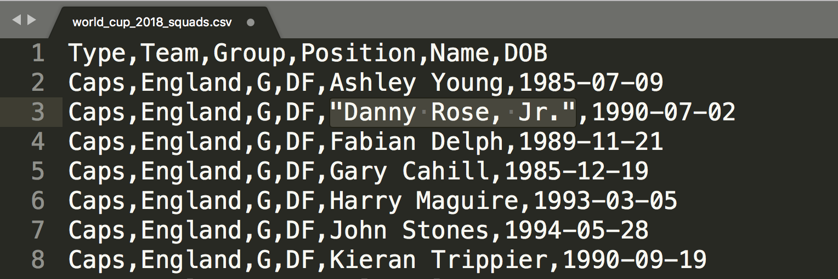
What to watch out for
Fix with quotes

Slide 23
What to watch out for
In pairs, fix this spreadsheet
Airbnb-comma.csv

Slide 24
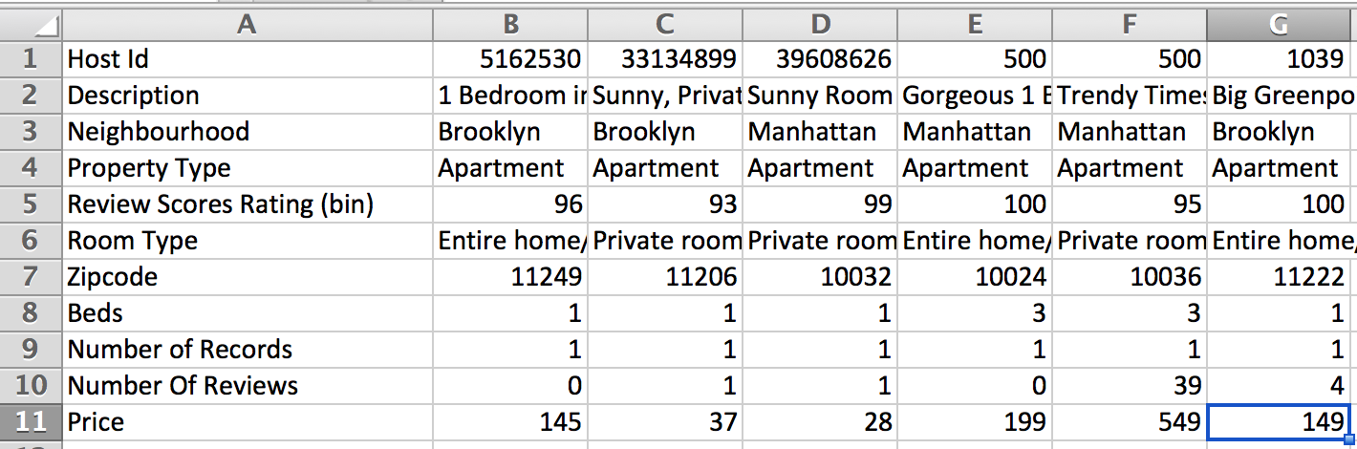
What to watch out for
Wrong-way (aka “fat”) data

Slide 25
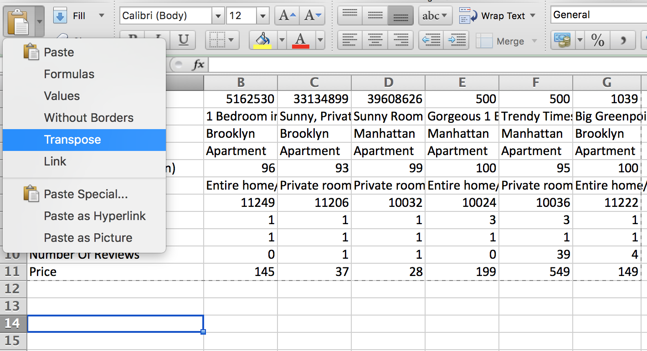
What to watch out for
Fix: Copy + Paste (transpose)

Slide 26
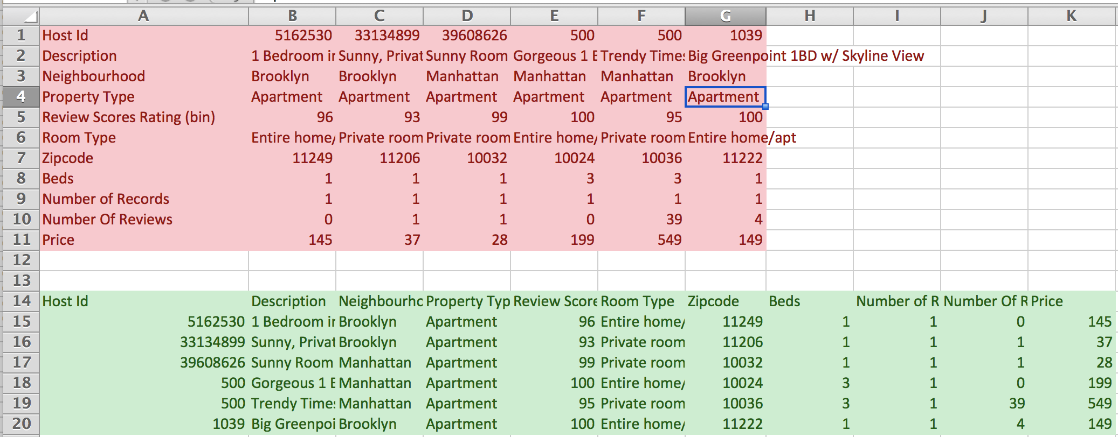
What to watch out for
Much better

Slide 27
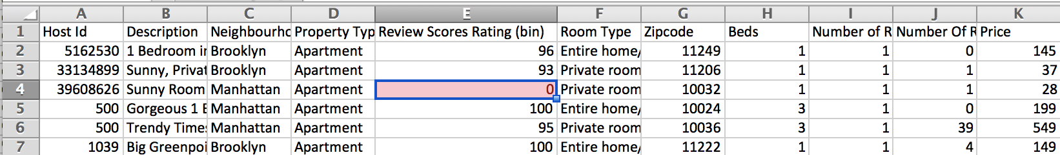
What to watch out for
Missing data
People will sometimes just BS what goes in there

Slide 28
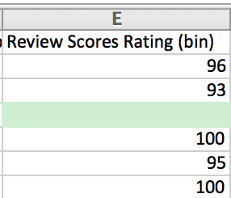
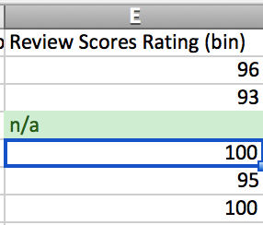
What to watch out for
Fix: Empty or put in missing indicator

Slide 29
What to watch out for
In pairs, clean this data
Airbnb-transpose-missing.csv

Slide 30
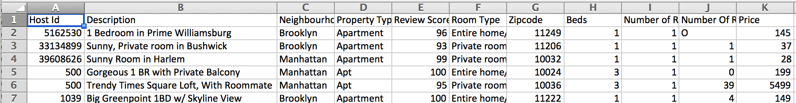
What to watch out for
Typos and/or data input inconsistency

Slide 31
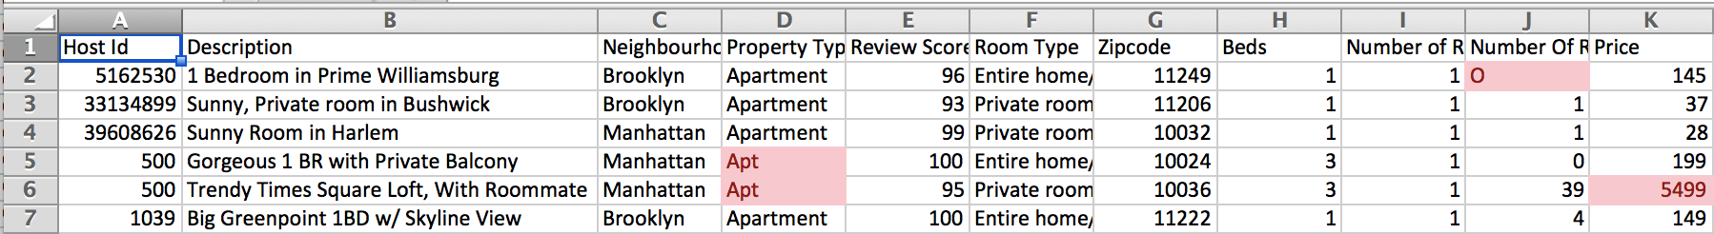
What to watch out for
Crazy outliers
Different formatting (letter O vs # 0)

Slide 32
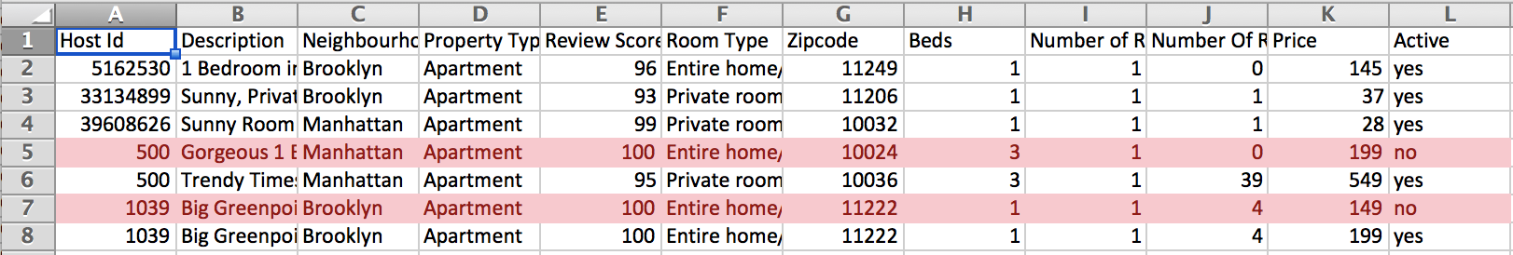
What to watch out for
Duplicates/amendments

Slide 33
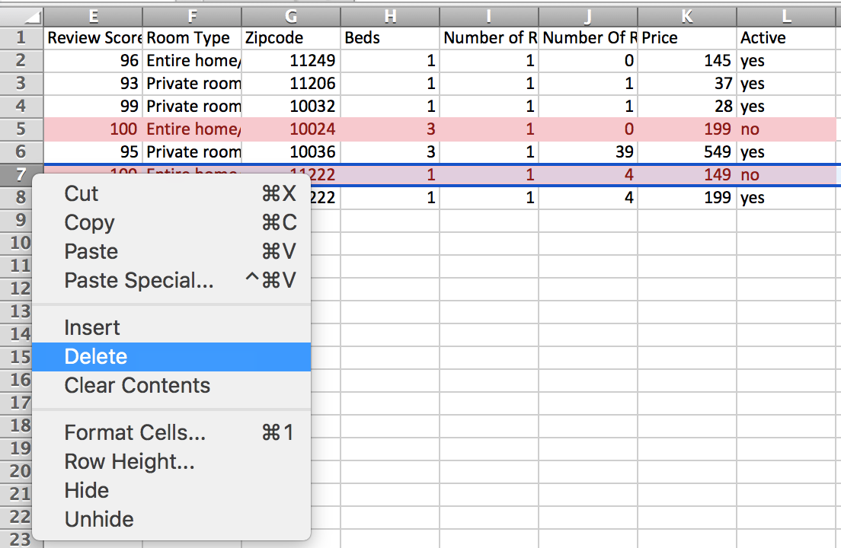
What to watch out for
Delete whole row by right clicking on row number

Slide 34
What to watch out for
In pairs, clean this data
airbnb-typos-amndmts.csv

Slide 35
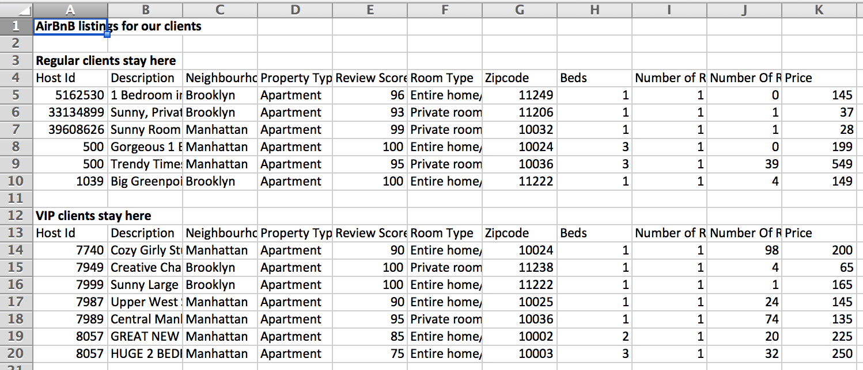
What to watch out for
Data broken into sections

Slide 36
What to watch out for
No need for title up top
Don’t want two headers
If groupings are important, add one (or more) data column(s)!

Slide 37
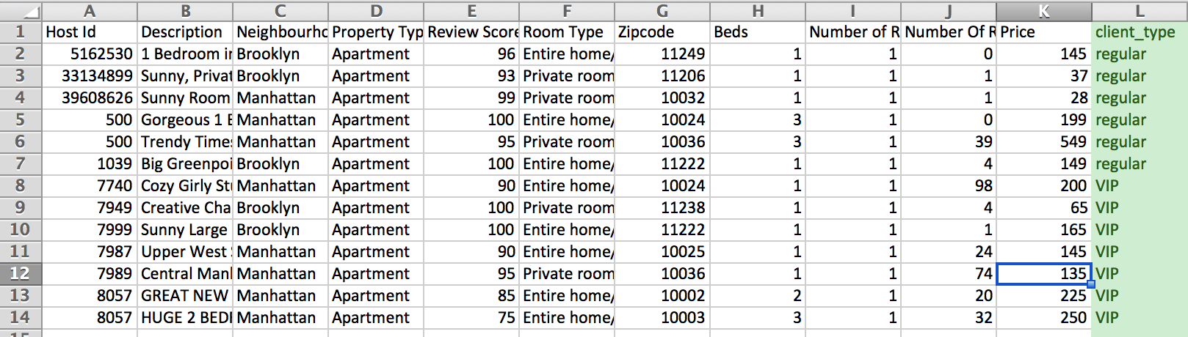
What to watch out for
Better ☺

Slide 38
What to watch out for
In pairs, clean this data
Airbnb-sections.csv

Slide 39
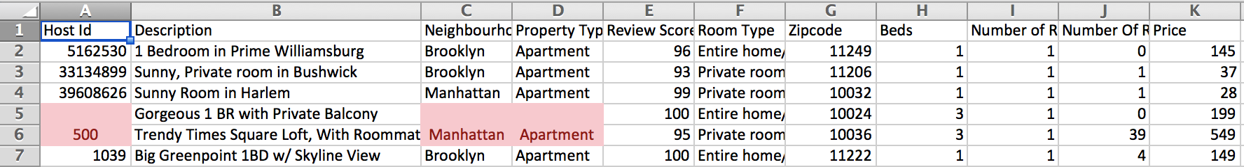
What to watch out for
Merged cells
People think they’re being ~*fancy*~
They’re not.
(They’re being dumb and should be ridiculed for it.)

Slide 40
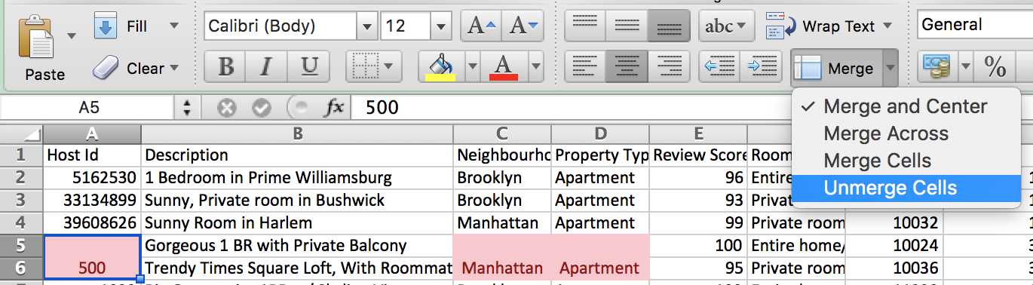
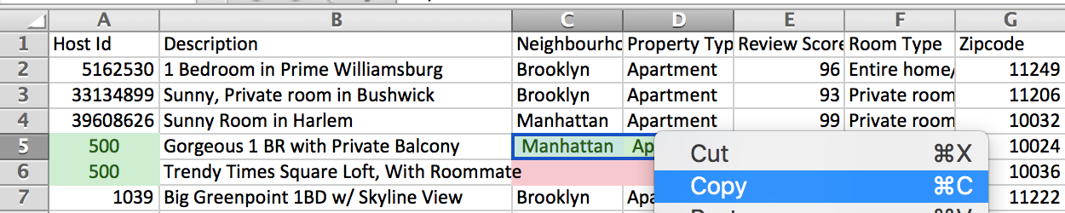
What to watch out for
Unmerge and copy the value to the blank cells

Slide 41
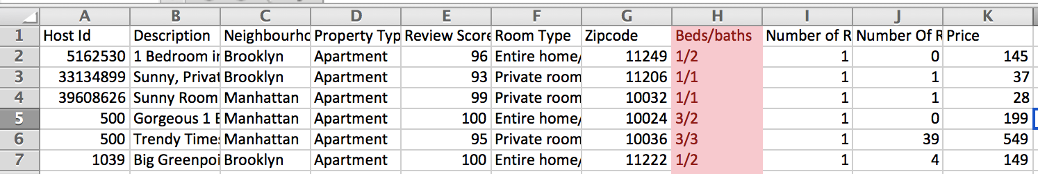
What to watch out for
Columns that should be split into two

Slide 42
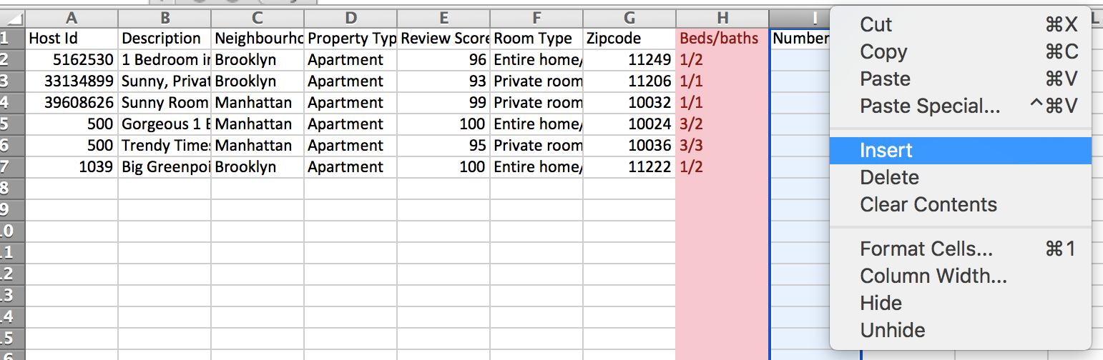
What to watch out for
Add a column next to it

Slide 43
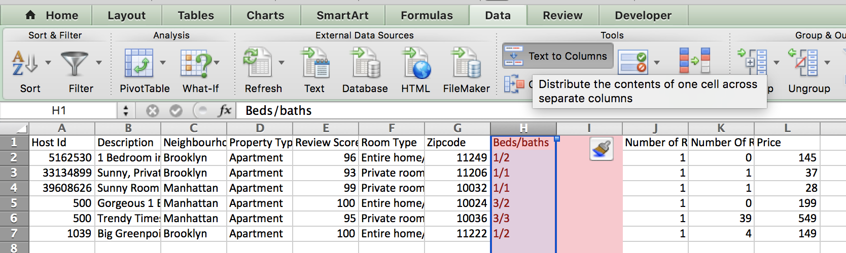
What to watch out for
Text to columns

Slide 44
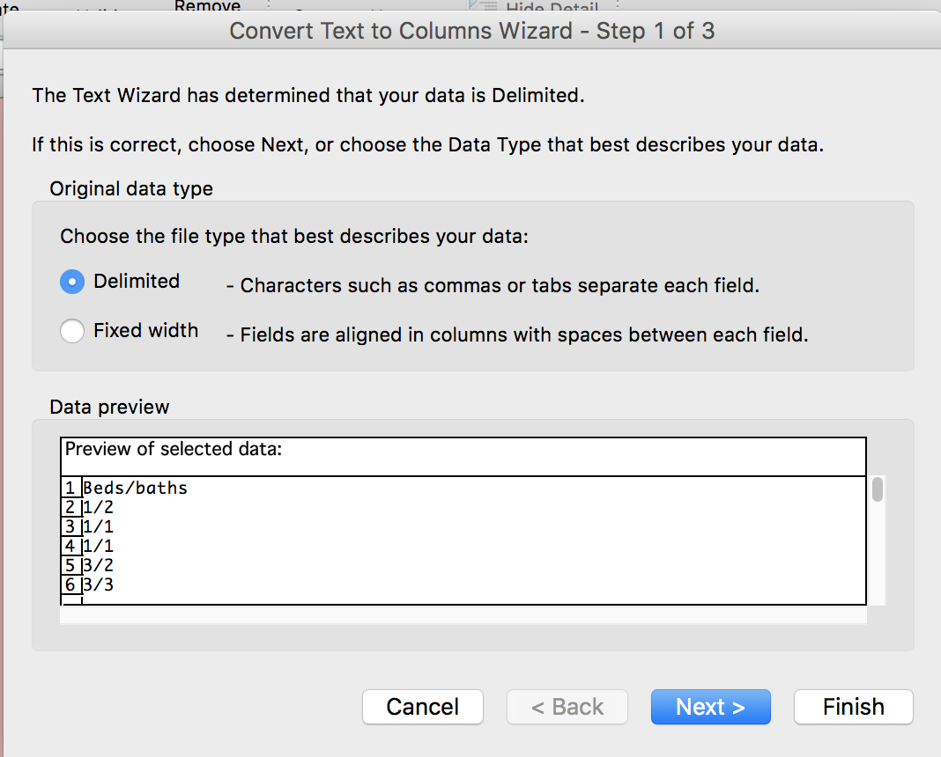
What to watch out for
Only works if data has a delimiter – something SEPARATING the data

Slide 45
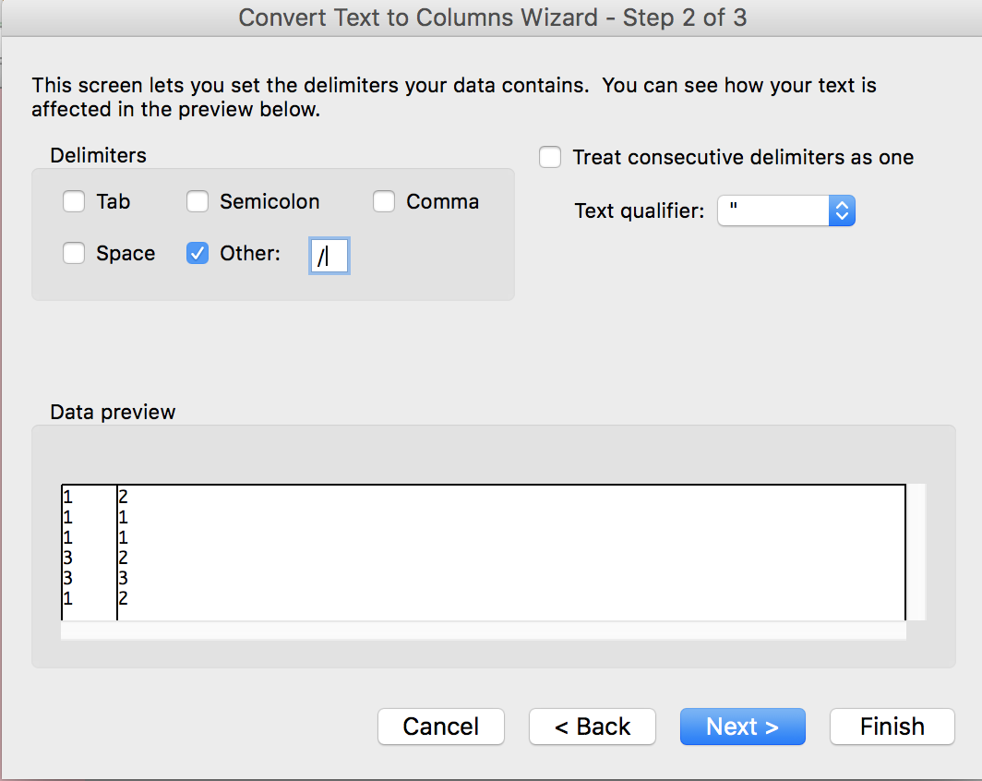
What to watch out for
Choose what your delimiter is

Slide 46
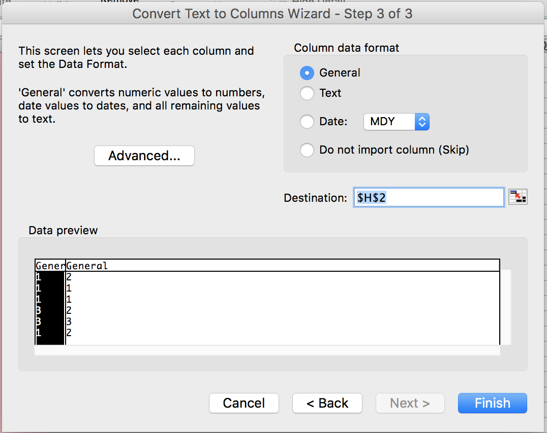
What to watch out for
Can leave this (puts data in same place)

Slide 47
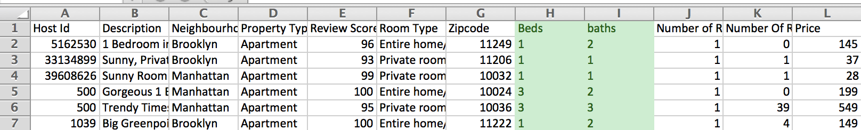
What to watch out for
Much better ☺

Slide 48
What to watch out for
In pairs, clean this data
Airbnb-cols.xlsx

Slide 49
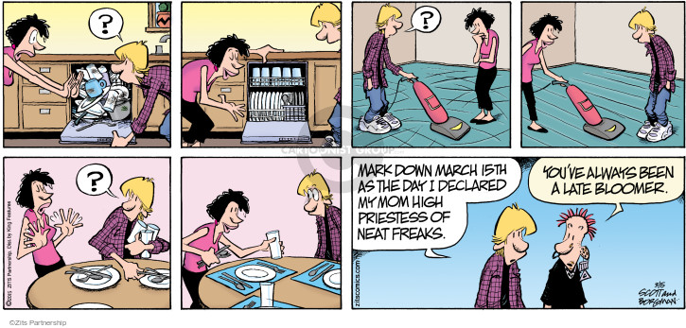
Cleaning techniques

Slide 50
Cleaning techniques
You can do everything by hand, one at a time, but UGH

Slide 51
Cleaning techniques
Select all blanks
Salary data for Chicago:
Hours “N/A” for salaried employees
Current_Employee_Names__Salaries__and_Position_Titles.csv

Slide 52
Cleaning techniques
Filter then change
Marijuana lobbying data:
Org ➔ Organization
Marijuana-lobby-namechange.csv

Slide 53
Cleaning techniques
Find and replace
Marijuana lobbying data:
Org ➔ Organization
Marijuana-lobby-namechange.csv

Slide 54
Cleaning techniques
ADVANCED find and replace
a.k.a. regular expressions
a.k.a. regex
a.k.a. misleadingly intimidating pile of garbage
^".*" or \n[A-Za-z]*\t or : "\d*”

Slide 55
Cleaning techniques
Downtown-crime-data.csv
Make own column for TIME
Prepend zero to times between 0:00 and 9:59

Slide 56
Cleaning techniques
Downtown-crime-data.csv
Make own column for TIME
Prepend zero to times between 0:00 and 9:59

Slide 57
Cleaning techniques
Assignment
Find a dataset to clean and document your steps
https://github.com/shmcminn/digitalframeworks-summer18/blob/master/class3/assignment3.md

